Slide 1
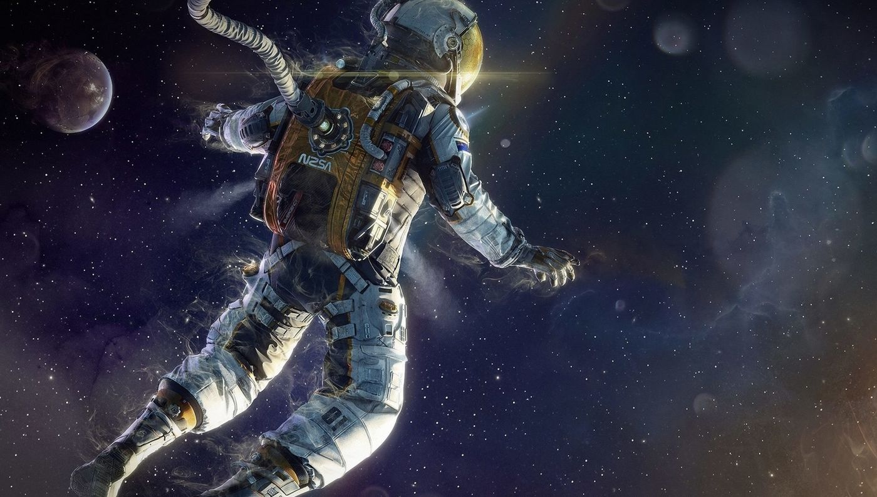
space traveler
Introduced by the student /
Lamar Turki Asiri

Slide 2
Introduction
space traveler
1- Space voyager offers space exploration and study of natural phenomena and physical objects that occur in outer space, and this program is a participatory program in the sense that while you can
2- It will be easy to reach success if you work in partnership with one of your colleagues, so try to find a friend who is willing to work with you to perform some difficult activities (challenges).

Slide 3
basic terms
1 - Telescope: an instrument that collects light from distant celestial bodies to form a close-up image of them.
2- Astronomical observation: Tracking celestial bodies, such as planets, constellations of stars and galaxies, a hobby that can be practiced with the naked eye, or industrial observers such as telescopes and others.
3 - Space probe: an unmanned vehicle (with a human inside) that is sent to space to conduct research and obtain images and information about planets or the sun's crater and star's surface for further study.
4 - Space Probe: An unmanned vehicle (inside which there is a human) that is sent into space to conduct research and obtain images and information about planets, moons, comets and asteroids in our solar system, and space probes carry special cameras and instruments deep into the solar system, and study planets and moons by flying over them, or landing on their surface, to study them closely.

